Slide 1

PADA Project presentation
Streaming Stock Data Analysis
Group Members:-
Mehul Dharmraj Patil [B194013]
Niranjan Vinod Patil [B194024]
Sanket Sunilkumar Sathe [B194036]
Prajwal Warad [B194092]

Slide 2
Introduction
Financial and stock market data is continuously increasing day by day.
When analyzing stocks, data comes from various sources at different intervals of time.
These sources need to be streamed in, joined together efficiently and then calculations and advanced analytics need to be applied.
Sometimes these sources need to be updated based on corrections made to the data.
Traditionally, this is all very hard to do.
Now with Delta Lake and Structured Streaming, this is all much easier.

Slide 3
Problem Statement & Objective
Problem Statement:
Time Consuming task for stockholder to read the entire stock market data which in turn results in appropriate analysis about stock price so our system helps to stockholders to analyze stock market data in short amount of time.
Objective:
To stream data which is collected from different source.
To analyze stock market data in graphical form.

Slide 4
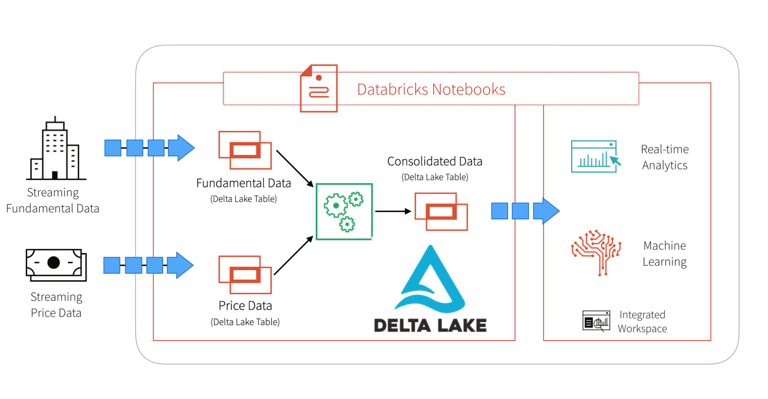
Architecture

Slide 5
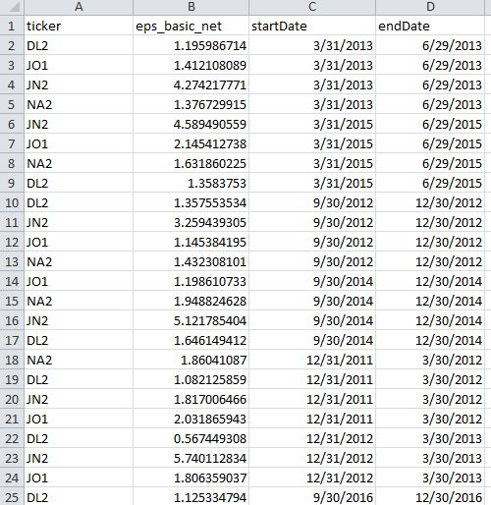
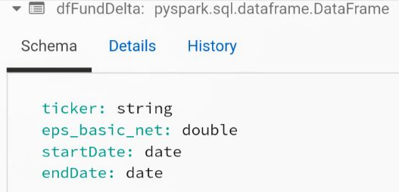
Dataset
Data source is quandle.com
1. Fundamental Dataset:
Fundamental Dataset has 4 columns
like ticker id (stock id), eps_basic_net,
start_date and end_date.

Slide 7
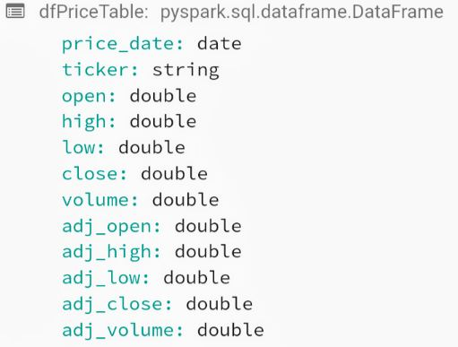
Dataset
2. Price Dataset:
Price Dataset has 12 columns like
price_date, ticker id (stock id),
open price, day high price,
day low price, close price, volume,
adjusted open, adjusted high,
adjusted low, adjusted close
and adjusted volume.

Slide 8
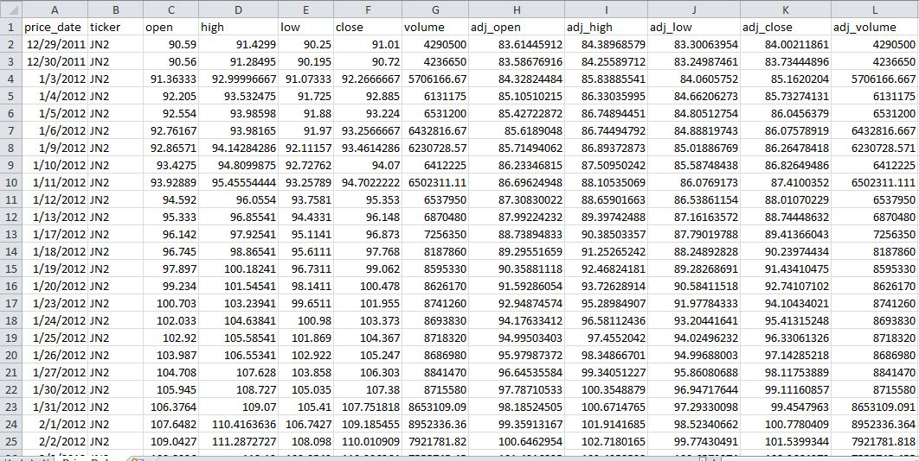

Slide 9
Demonstration
Dataset setup
Data Streaming
Dataset Analysis by SQL Query in graphical form

Slide 10
Results Analysis
We can see line graph of price of different stock tickers and compare their price for particular period.
Second graph of fundamental dataset which shows higher EPS indicates more value because investors will pay more for a company with higher profits. JN2 stock ticker has highest EPS.
By comparing P/E ratio of two stocks we will find stock ticker which has highest demand and that stock ticker will be provide earning profit to stockholder in the future.
We also find and compare average price of different stock ticker. JN2 stock ticker has highest average price.

Slide 11
THANK YOU

